Slide 1
Glass Protective League Update
November 5th, 2024
Pittsburgh, PA

Slide 2
Kevin Hardie GPI Protective League Consultant

Slide 3
End Market Share of U.S. Glass Container Shipments by Category (YTD, Through August 2024)
Cosmetics/Pharma/Toiletries (0.046%)
Source: Glass Packaging Institute, Precision Consulting
Notes:
Early data shows wine’s overall share down 2 percent, with beer and food gaining one point each

Slide 4
Key Glass End Markets - Changes Over Time
Beer
2008 - 59%
2012 - 58%
2016 - 56%
2019 - 51%
2020 – 46%
2021 – 46%
2022 – 45%
2024 (Aug) – 45%
Food
2008 - 17%
2012 - 17%
2016 - 18%
2019 - 20%
2020 – 24%
2021 – 23%
2022 – 23%
2024 (Aug) – 25% (plus 1)
Wine
2008 - 6%
2012 - 7%
2016 - 8%
2019 - 9%
2020 – 9%
2021 9%
2022 – 10%
2024 (Aug) – 9% - (minus 1)
Ready to Drink (RTD) Alcoholic Beverages
2008 - 7%
2012 - 6%
2016 - 5%
2019 - 6%
2020 – 5%
2021– 6%
2022 – 5%
2024 (Aug) – 5%
Notes:
Change from 2022 to 2021 – Wine goes to 10% of overall share – Ready to Drink Alcoholic Beverages Decrease one percent (6 to 5)

Slide 5
Key Glass End Markets - Changes Over Time
Non-Alcoholic Beverages
2008 - 8%
2012 - 8%
2016 - 9%
2019 - 9%
2020 – 10%
2021 – 10%
2022 – 10%
2024 (Aug) – 10%
Spirits
2008 - 3%
2012 - 4%
2016 - 4%
2019 - 5%
2020 – 6%
2021 – 6%
2022 – 7%
2024 (Aug) – 6 (Minus 1)
Note – The Cosmetics/Pharma Category Registers as 0.46% of End Market
Share

Slide 6
US Glass Plant Shipments to Customers (listed in billions of bottles), 2017 – August 2024
20.44 B
11.6 B
6.6%
4.8%
2.4%
3.6%
10.1%
8.8%
Source – Precision Consulting, Representing ~95% of US Glass Container Plants

Slide 7
US Beer Bottle Shipments to Customers (listed in billions of bottles), 2017 – Thru August 2024
11.00 B
11.50 B
9.48 B
8.47 B
5.90 B
11.7%
13.6%
4.5%
10.6%
11.7%
Source – Precision Consulting, Representing ~95% of US Glass Container Plants
Notes:
Steep declines in beer shipments have leveled off the past year and a half – managing a couple of positive quarters over the past six

Slide 8
US Wine Bottle Shipments to Customers (listed in billions of containers), 2017 – August 2024
2.04 B
1.95 B
1.93 B
1.97 B
1.95 B
1.69 B
1.20 B
1.07 B
1.2%
0.9%
2.4%
1.4%
13.6 %
5.2%
10.9%
Source – Precision Consulting, Representing ~95% of US Glass Container Plants

Slide 9
US Spirits Bottle Shipments to Customers (listed in millions and billions of containers), 2017 – August 2024
10.2%
1.308 B
1.174 B
806 Mil.
756 Mil.
2.5%
2.9%
2.5%
10.4 %
5.7%
Source – Precision Consulting, Representing ~95% of US Glass Container Plants
Notes:
Spirits continue to increase, as measured in glass shipments to customers. This can be attributed to a steady growth in craft distilleries, and a continued increase for spirits as part of their overall alcohol market share,.

Slide 10
US Food Container Shipments to Customers (listed in billions of containers), 2017 – August 2024
5.01 B
4.67 B
4.65 B
4.51 B
4.76 B
4.70 B
4.25 B
2.94 B
2.86 B
10.0%
5.0%
3.7%
9.4%
2.7%
0.3%
3.0%
Source – Precision Consulting, Representing ~95% of US Glass Container Plants

Slide 11
Marketing & Communications Program

Slide 12
Marketing Strategy
GPI has been applying a multipronged marketing strategy
Increased Social Media engagement
SEO/Digital Strategy
Responsiveness to TTB
Wine Marketing - Targeted Paid Ads
2024 EcoFocus Survey, completed with results that will inform GPI's education content creation

Slide 13
Targeted Advertising Supporting North American Bottles

Slide 14
Targeted Advertising Supporting North American Bottles

Slide 15
Marketing
Social Media
KEY METRICS
ALL PLATFORMS
Increased visibility for glass packaging & glass recycling education across all GPI channels.
FOLLOWERS
REACH
ENGAGEMENT
20k
227k
17k
↑3.6%
↑4,000%
↑1,665%
*based on data from the last 90 days

Slide 16
Marketing
Social Media
Social Media
KEY METRICS
BY SOCIAL CHANNEL
Boosting consumer demand for glass in alignment with growing eco-friendly option demands and trends.
FACEBOOK
LINKEDIN
INSTAGRAM
TWITTER/X
TIKTOK
6,344
8,607
807
4,222
34
followers
followers
followers
followers
followers
+.09%
+7.2%
+13.2%
+.02%
+100%
follower growth
follower growth
follower growth
follower growth
follower growth
*based on data from the last 90 days

Slide 17
EPA Activity
GPI recently met with the EPA (at their request) to discuss a potential new MACT standard for glass container furnaces, air emissions and energy issues
The EPA is looking at options that include either a numeric emission limits, or implementing practices based on best performing 12% of container sources
A MACT Standard would also include a comprehensive review of furnace types currently in use
A chromium limit for gas-fired/oxyfuel furnaces may also be considered
GPI emphasized the best and most effective way to reduce energy use and emissions at the plants is by increasing recycled glass use, and avenues and paths to obtain more recycled glass should a primary focus of any future rulemaking
Note – this is only for discussion at the moment – the EPA is looking at an Advanced Notice of Proposed Rulemaking in 2026. The election outcome may have a bearing on whether or not this standard is pursued

Slide 18
TTB – Size Request and Rulemaking Update
TTB Fill Size Rulemaking
As part of a broader rulemaking, in July 2022 GPI submitted comments to the U.S. TTB (federal regulatory agency for the alcohol industry, housed under the Treasury Dept.), asking for specific size approvals for glass containers in the spirits and wine categories.
One of GPI's size requests (12 ounce/355ml for spirits) has long been approved for metal containers, based on an older statute referencing closures and container shape
Over the past 11 months, GPI has met with counsel and staff from the U.S. Senate Finance and House Ways and Means Committee, along with several Member offices, to educate them on the issue, and to push a decision forward from TTB
Update – As part of a GPI-driven 30-day comment period last month, TTB reopened consideration of fill sizes
GPI and member companies commented on the need for removal of restrictions for glass containers in spirits and wine fill sizes, placing an emphasis on the 355ml (12-ounce) bottle size for spirits

Slide 19
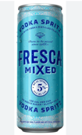
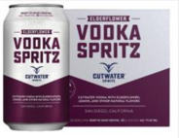
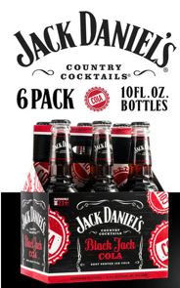
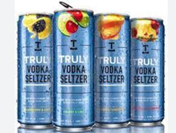
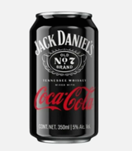
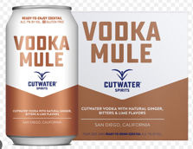
Current Marketplace Examples for 355ml Mixed Spirits
Spirits in 10-ounce glass bottles “ok”
More popular 355ml (12-ounce) size currently approved ONLY for metal cans
355ml spirits size approval for glass would open up additional customer markets

Slide 20
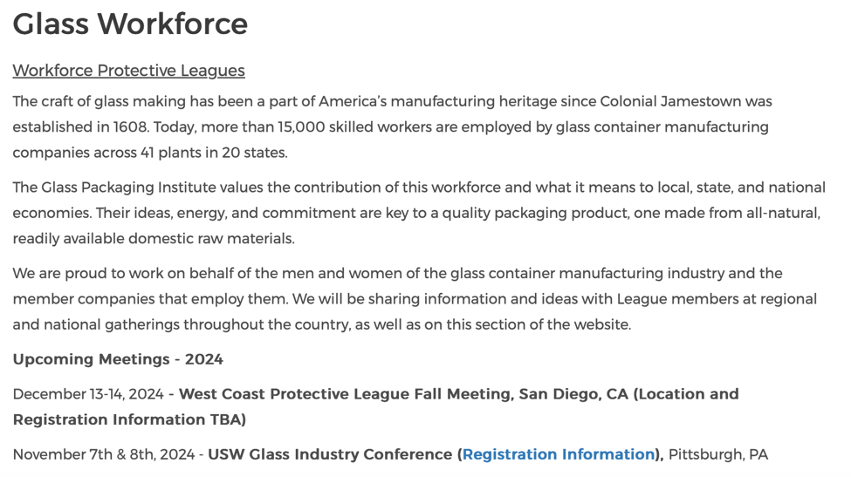
Visit GPI’s Workforce Section

Slide 21
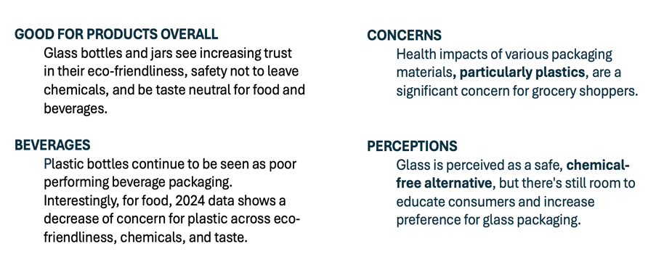
Marketing
2024 EcoSurvey
KEY TAKEAWAYS

Slide 22
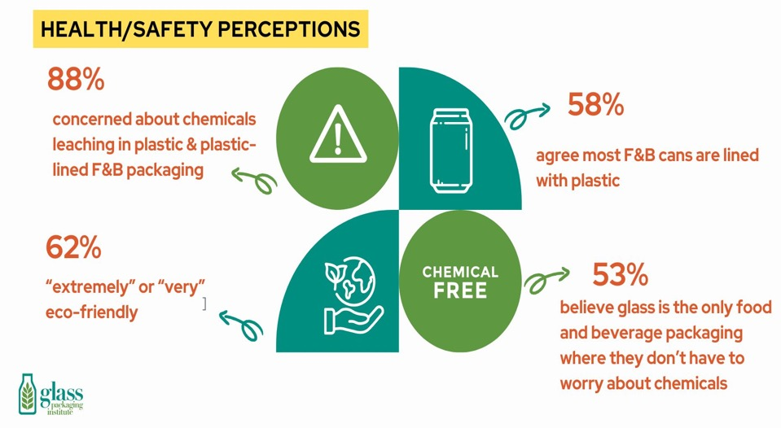
EcoFocus

Slide 23
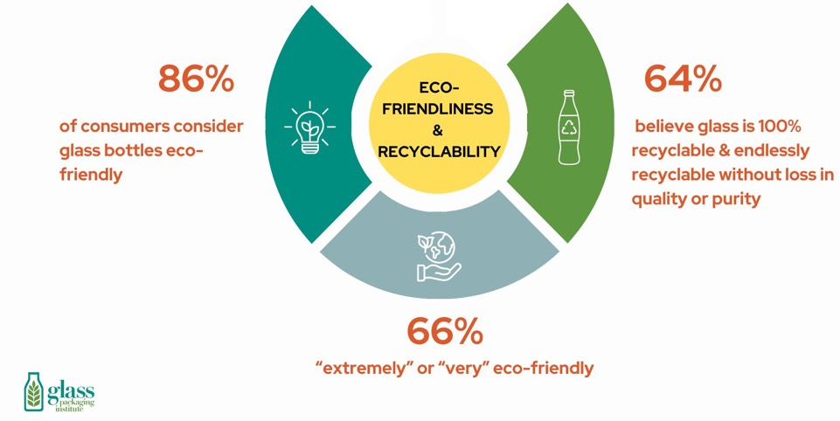
EcoFocus

Slide 24
GPI and member companies continue to engage regulators and other stakeholders on extended producer responsibility (EPR) requirements for CA, CO, IL, MD, ME and OR
EPR programs require brand packaging in glass, and other packaging formats to pay for the bulk of in-state recycling programs
GPI seeks to make sure glass is not competitively disadvantaged with respect to cans, plastic or aseptic packaging, as fees and other requirements are established for brands

Slide 25
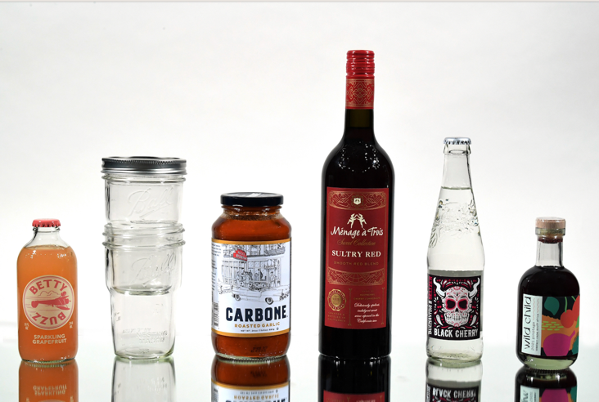
2025 Clear Choice Award Nominations Open

Slide 26
2025 Clear Choice Award Categories
Beer, Cider & Flavored Alcoholic Beverages
Food
Spirits
Wine
Non-Alcoholic Beverages
Cosmetics, Fragrances & Pharmaceuticals
Innovation & Sustainability
Global Member Container
RTD (Spirits)

Slide 27
Thank You Enjoy the Meeting!

Slide 28
For More Information Kevin Hardie GPI Protective League Consultant NickelSolution@Yahoo.com

